Slide 1
Improving Spam Filtering by Detecting Gray Mail
Scott Wen-tau Yih, Robert McCann & Alek Kolcz
Microsoft Corporation

Slide 2
Good vs. Spam Only?
Good mail: messages users definitely want
Personal communication, business transactions
Spam mail: unsolicited messages
Stock scam, phishing messages, illegal products
Gray mail: messages users disagree on labels
Unsolicited commercial email (sometimes useful)
Newsletters that do not respect unsubscribe requests
Either prediction (spam or good) is justifiable

Slide 3
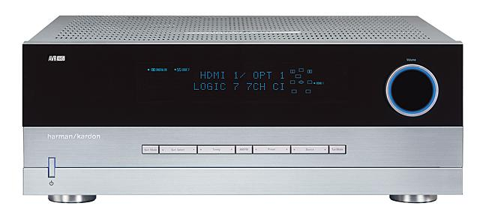
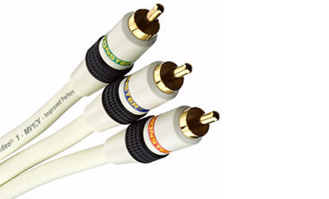
Gray Mail: User's View
Last month I bought a home theater receiver from HiFi.com.
A week later, I started to receive ad email…
Good Mail!
Monster Component Video Cable – 50% off!

Slide 4
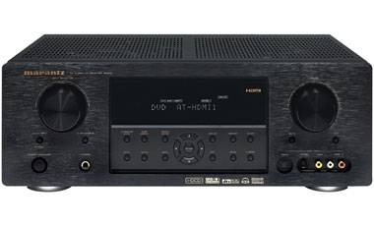
Gray Mail: User's View
Last month I bought a home theater receiver from HiFi.com.
Next advertising email from HiFi.com…
Junk Mail!
Marantz SR4001
$499 Free Shipping!

Slide 5
Gray Mail: System's View
Monster Component Video Cable – 50% off!
Monster Component Video Cable – 50% off!
Monster Component Video Cable – 50% off!
Monster Component Video Cable – 50% off!
Should we deliver this message to users or not?

Slide 6
Why is Gray Mail Important?
Problems due to the existence of gray mail
Imprecise evaluation of spam filters
For an email campaign with 60% labeled as spam, the best prediction generates 40% false-positive cases
Noisy training labels
Same messages with different labels
With gray mail detection, we can
Have different training/testing policies
Provide more personalization options

Slide 7
Outline
Introduction
Methods of detecting gray mail
Committee of spam filters
Learning from mixed sender mail
Learning from gray mail campaigns
Application of gray mail detection
Improving spam filtering
Conclusions

Slide 8
Detecting Gray Mail
Challenge – Lack of labeled data
Lots of messages with labels good or spam
Annotators do not give their confidence on labels
Unclear which messages are gray mail
Cannot train a gray mail classifier directly
Methods
Committee of spam filters
Learning from mixed sender mail
Learning from gray mail campaigns
Change labels to gray mail or not

Slide 9
Committee of Spam Filters
Idea: measure the disagreement
Gray mail: messages that users disagree on labels
Train several spam filters using different training data
Test whether these filters disagree on predictions
Procedure
Train 10 filters using logistic regression on 10 disjoint subsets of training data
Disagreement of a test message: variance of the output scores (estimated probabilities)

Slide 10
Learning from Mixed Sender Mail
Idea: treat mixed senders as gray mail senders
Mixed sender: messages labeled as good or spam
Sending both good and spam messages
Sending gray mail messages
Treat all these messages as gray mail
Procedure
Consider senders (IP24) with > 10 messages
Mixed sender: spam ratio between 20% and 80%
Train a gray mail classifier using logistic regression

Slide 11
Learning from Gray Mail Campaigns
Idea: find gray mail campaigns in training data
Find email campaigns (identical msgs) in labeled data
Treat messages as gray mail if disagreement is high
Procedure
Near-duplicate detection [Kolcz&Chowdhury CEAS-07]
Consider campaigns with more than 10 messages
Gray mail: spam ratio between 20% and 80%
Train a gray mail classifier using logistic regression

Slide 12
Gray Mail Detection Experiments
Data: Hotmail Feedback Loop
Hotmail messages labeled as good or spam
Obtained by polling over 100K users daily
Training: 800K messages from Jan ~ Aug, 2006
Testing: 418 messages from Sep ~ Nov, 2006
Labels: gray or not gray
Compare results using recall-precision curves

Slide 13
Results in Recall-Precision
Precision
Recall

Slide 14
Application: Improving Spam Filtering
A two-filter architecture
Separate gray mail from other mail
Train two filters based on gray mail and other mail, resp.
Experimental setting
Training: 300K messages from Sep to Nov, 2006
Testing: 100K messages from Dec, 2006
Gray mail detector: learning from gray mail campaigns
Results: reducing the false-negative rate by 2%~6% in the low false-positive region

Slide 15
Conclusions
The problem of gray mail
Messages that are not clearly spam or good
Noisy training data, imprecise evaluation of filter quality
Pioneer study on gray mail detection methods
Committee, mixed sender mail, gray mail campaigns
Learning from gray mail campaigns is generally better
Future work
Investigate more methods for gray mail detection
Better training data, different ML frameworks, sender information
Explore applications in email personalization

